Slide 1
Flight Price Prediction
BY,
VIJAY RODRIGUES

Slide 2
PROBLEM STATEMENT:
Anyone who has booked a flight ticket knows how unexpectedly the prices vary.
The cheapest available ticket on a given flight gets more and less expensive over time.
This usually happens as an attempt to maximize revenue based on - 1. Time of purchase patterns (making sure last-minute purchases are expensive) 2. Keeping the flight as full as they want it (raising prices on a flight which is filling up in order to reduce sales and hold back inventory for those expensive last-minute expensive purchases)
So, you have to work on a project where you collect data of flight fares with other features and work to make a model to predict fares of flights.

Slide 3
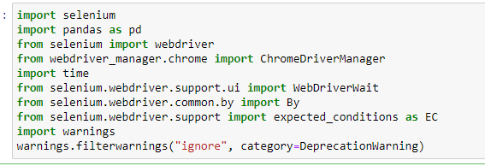
EDA STEPS / DATA PRE-PROCESSING DONE
Acquire the data and converting to dataset
Import the libraries:
I have considered kayak.com travel website to scrape flight details using Selenium Webdriver.

Slide 4
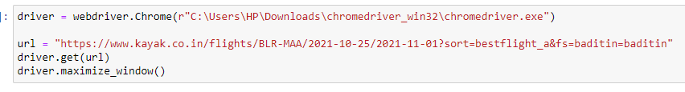
B) Establish connection to webdriver and fetch URL

Slide 5
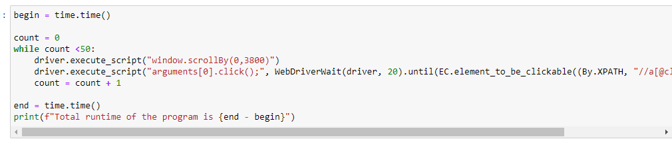
C) Scroll the page and select the button several times

Slide 6
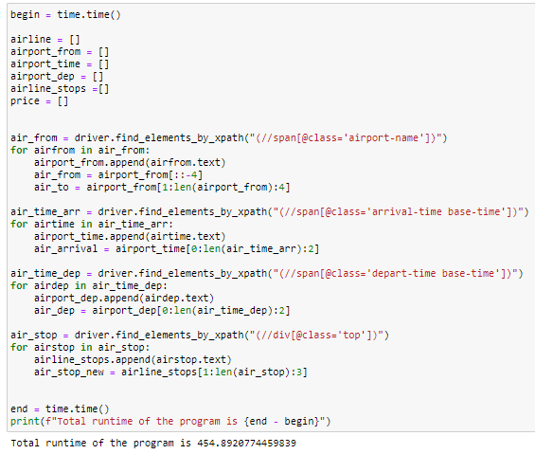
D) Data Extraction
All the necessary data is extracted and stored in respective variables for later use.

Slide 7
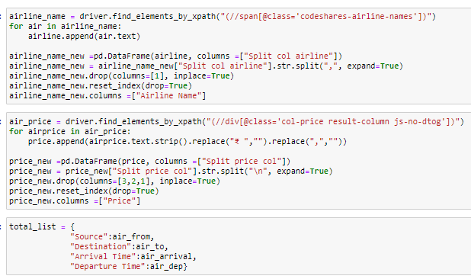

Slide 8
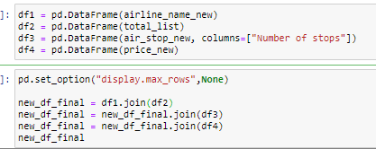
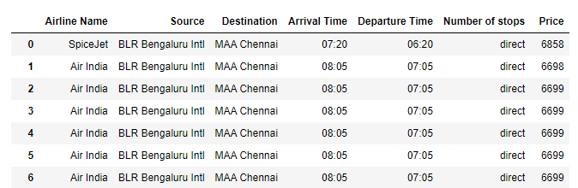
E) Conversion of the extracted data into a DataFrame

Slide 9
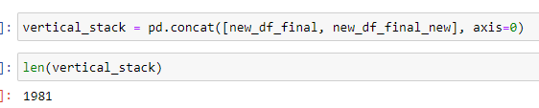
F) Combination of DataFrames
I have extracted 2 separate data from same website and combined both the dataframes into one by stacked one above another as follows:

Slide 10
G) Convert the final dataframe into a CSV file (index removed)

Slide 11
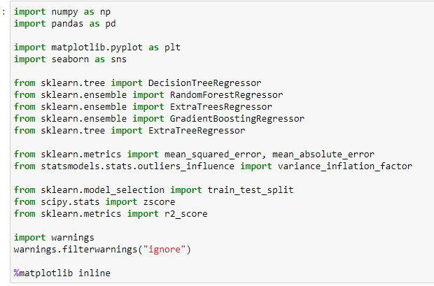
2. IMPORT ALL THE CRUCIAL LIBRARIES
For this project I have used the following major libraries like Pandas-profiling, Pandas, Matplotlib and Seaborn that are used for EDA or any other pre-processing done in this scenario.

Slide 12

3. IMPORT THE DATASET
The dataset is in CSV format and it is imported using Pandas library in Jupyter Notebook.
The statement pd. set_option("display.max_columns", None) simply allows us to physically see all the feature columns.
The statement pd. set_option("display.max_rows", None) simply allows us to physically see all the feature rows.
By default, Jupyter Notebook doesn’t display all the rows and columns at the same time and only selected portion from starting and ending of dataset are displayed.

Slide 13
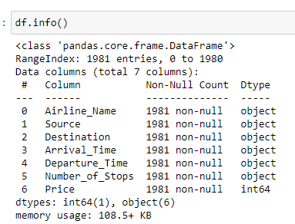
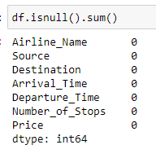
4. IDENTIFYING AND HANDLING THE MISSING VALUES
There are no missing values hence no actions have been taken

Slide 14
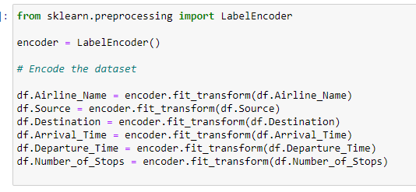
5. ENCODING THE CATEGORICAL DATA
I have used LabelEncoder as the data is categorical and is not ordinal in nature.

Slide 15


6. SPLITTING THE DATASET
Splitting up of dataset between x (features) and y (target column).
Split the dataset into train and test data set.
I have chosen 200 random state and 30% of data is divided in text dataset.

Slide 16
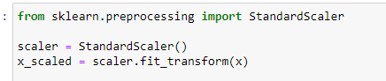
7. FEATURE SCALING AND STANDARDIZATION
Finding variance inflation factor in each scaled column
This gives us relationship between feature vs feature and we can drop if necessary to avoid multicollinearity.
From the below observation, I have not considered this step.
Also without dropping the features I got even better accuracy in the final model.
Let’s us now Scale the data for further processing.
we have used StandardScaler for further scaling up of data

Slide 17
ASSUMPTIONS CONSIDERED
This dataset contains only 1981 records and has only 7 features. It depends entirely on the websites referred to.
Since this dataset is not possible to extract for multiple dates through web scraping, I have considered only 25th Oct 2021 as the date.

Slide 18
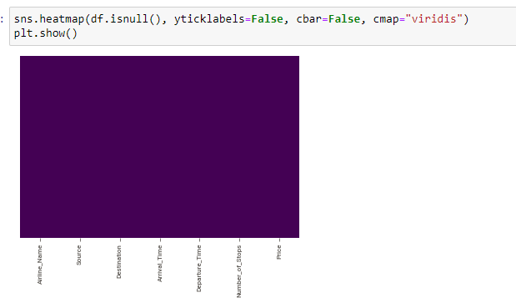
Visualizations
This heat map indicates if there are any missing values. Since all the values are accounted for, there is no change in color of the graph.

Slide 19
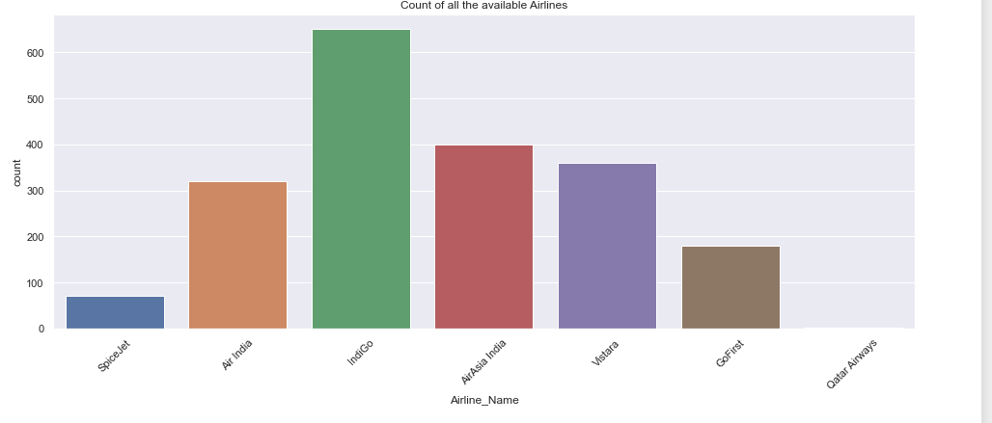
From the below plot with respect to training dataset, we can see that IndiGo holds a large share of business in this sector with about 32.86 % followed by AirAsia India and Vistara.
However this data is valid only for the date 25th Oct 2021.

Slide 20
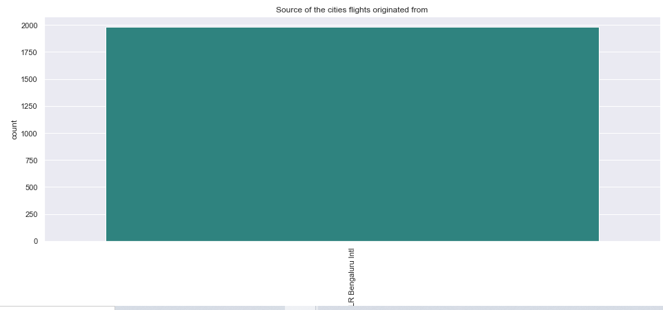
Since this data was scraped from a website Kayak.com, the source is the same i.e. Bangalore and hence we have no other places.

Slide 21
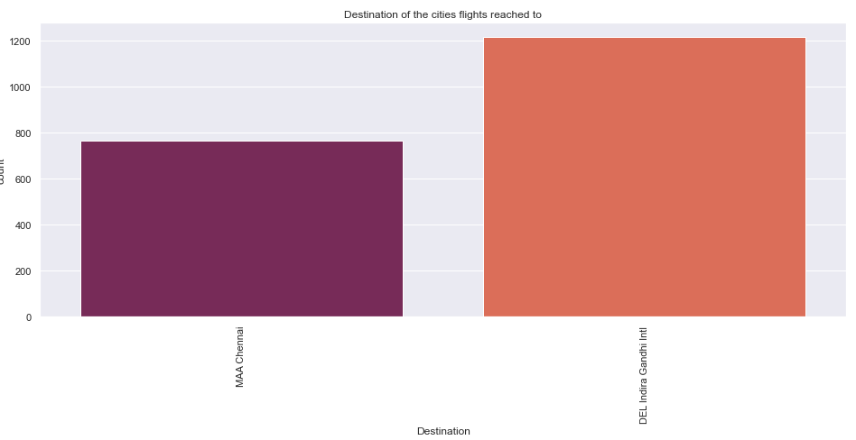
We can see from the below plot that people live in Delhi compared to Chennai.
This data cannot be generalized because these were the only destinations that appeared in the search bar.
Also, Chennai being one of the busiest metropolitan cities, we can see why a lot of passengers seem to travel there.

Slide 22
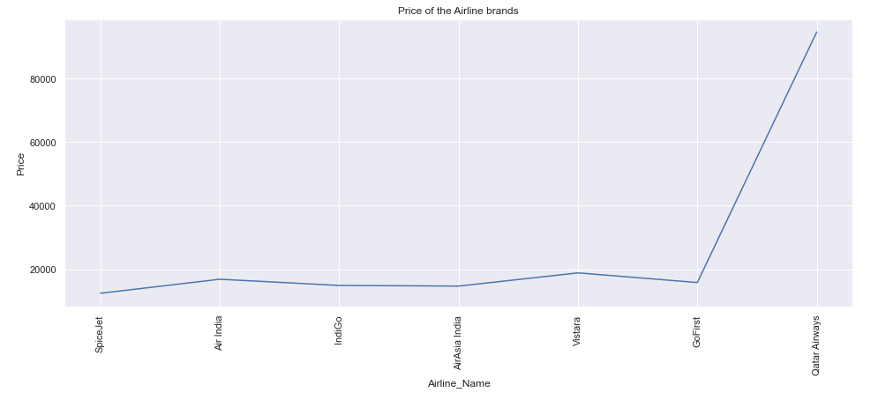
e can see from the below plot the airline prices for all the companies. It appears Qatar Airways has the highest price for the ticket compared to other airlines.
It could be because all the remaining flights are domestic and Qatar Airways is the only international flight operating amongst these. The tariff changes, etc may seem to affect. Moreover prices depend on the brand and it's purchase power and Qatar Airways have a good stake in airline industry.
This could be the reason for the massive price hike for domestic travel.
However, in general the price of the ticket should not cost more than 15,000 to 20,000 Rs. and Qatar Airways tickets are going above 80,000.

Slide 23
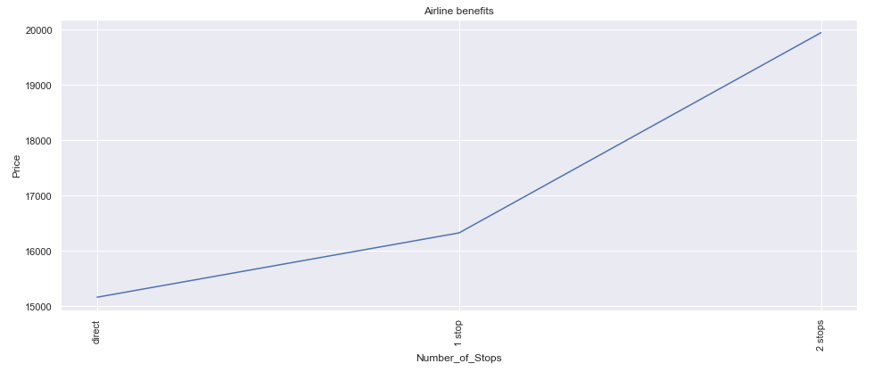
From the below plot we can see how the total stops influence prices.
In general sense, flights with single or no stops are cheaper than flights having multiple stops. But in this case we can see that flights with 2 stops have a higher price compared to the other flights.
Having multiple stops means the airline is liable for hangar rent, and other taxes and unless they plan to travel far, having additional stops will add more cost to the airline companies.

Slide 24
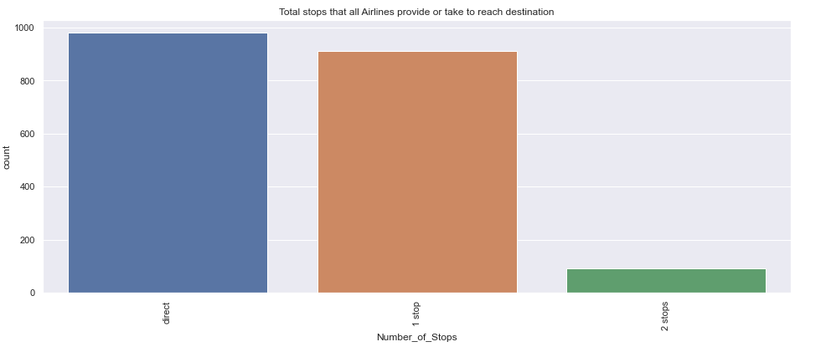
The below plot shows us the number of stops given by flights
We can see the majority of flights have "one stop" and this shows that flights have reached directly to the destination with more time for halt.
This also tells us that for domestic travel passengers do not prefer connecting flights as it's time consuming.
However we can also see that people have opted for "non-stop" flights. These are the same as "one-stop" but here there is essentially no stop at all. Flight may take time to refuel and that's it.
This is common for all economy flights or airlines that have cheap tickets because stopping at an airport means the airline company has to pay parking fees that could be huge even if it means staying only for sometime.

Slide 25
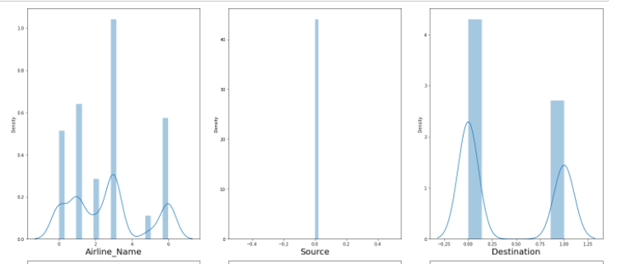
The below plot shows us the distribution of the dataset. Since all are categorical variables and the only numerical variable “Price” is a target variable, we are not making any changes.

Slide 26
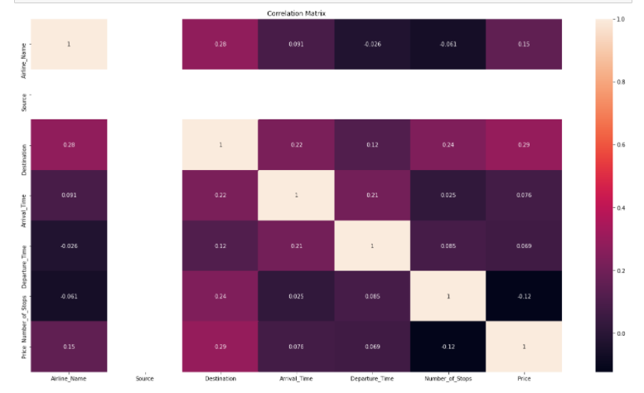
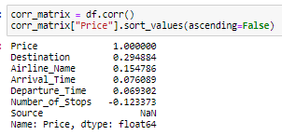
Let us now examine correlation using a "heatmap" for further clarification.

Slide 27
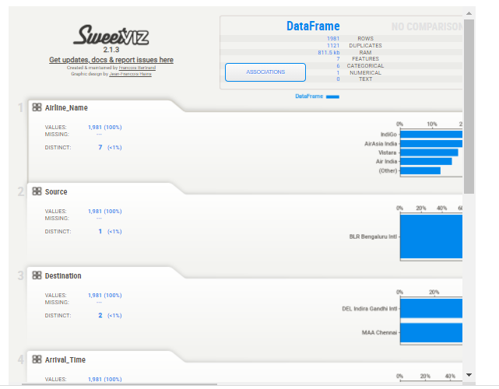
Sweetviz library dashboard that gives us results on association of various variables.

Slide 28
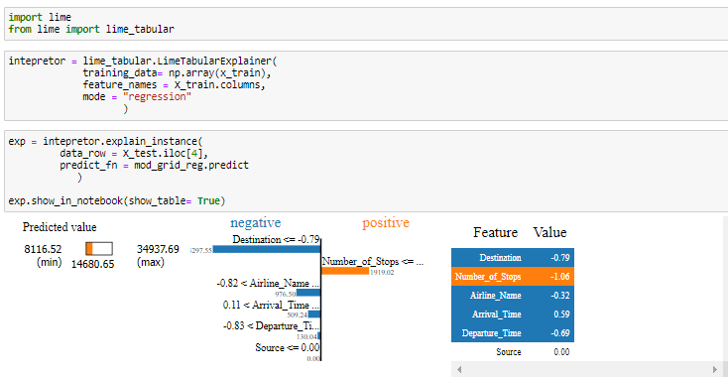
Model dashboard using Lime library

Slide 29
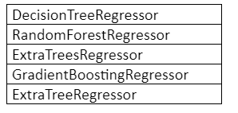
FOR THE MODEL BUILDING I HAVE CONSIDERED THE FOLLOWING 5 ALGORITHMS FOR THE TRAINING AND TESTING.

Slide 30
RUN AND EVALUATE SELECTED MODELS
II have used a total of 5 machine learning algorithms to find the best and suited model which also includes ensemble algorithms.
I have considered Adjusted R2 score for model evaluation.
Along with this I have also calculated Mean Absolute Error (MAE), Mean Squared Error (MSE) and Root Mean Squared Error (RMSE) as evaluation techniques.

Slide 31
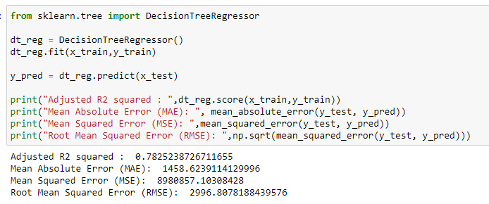
1) DecisionTreeRegressor
From the below algorithm we can see the accuracy score for DecisionTreeRegressor is approximately 78.25%.

Slide 32
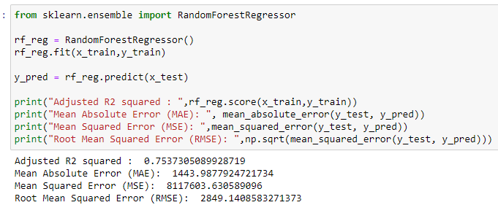
2) RandomForestRegressor
From the below algorithm we can see the accuracy score for RandomForestRegressor is approximately 75.37 %.

Slide 33
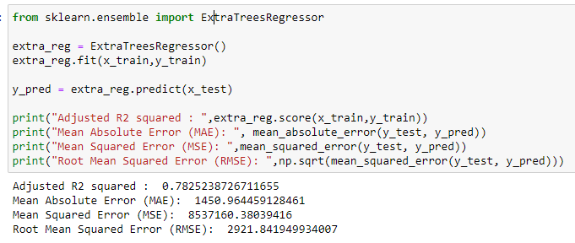
3) ExtraTreesRegressor
From the below algorithm we can see the accuracy score for ExtraTreesRegressor is approximately 78.25 %.

Slide 34
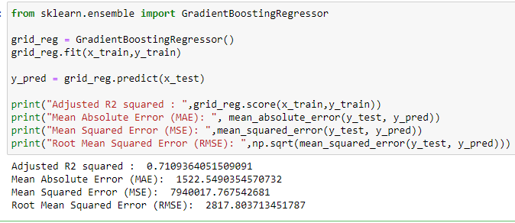
4) GradientBoostingRegressor
From the below algorithm we can see the accuracy score for GradientBoostingRegressor is approximately 71.09 %.

Slide 35
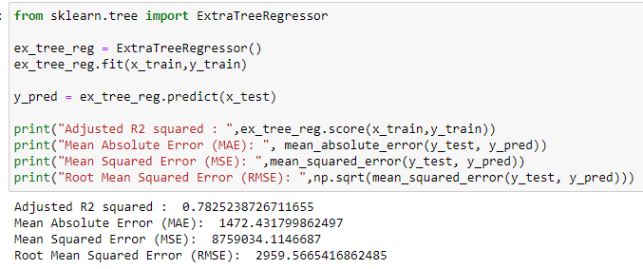
5) ExtraTreeRegressor ( not ensemble )
From the below algorithm we can see the accuracy score for ExtraTreeRegressor ( not ensemble ) is approximately 78.25 %.

Slide 36
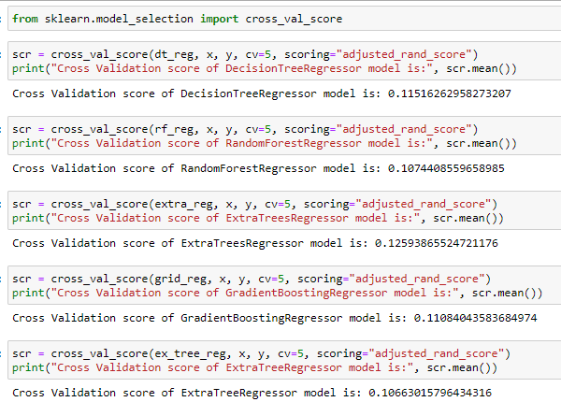
CROSS VALIDATION
The below code shows us the cross validation performed over all the algorithms and I have used the CV values as 5.
If you observe the below screenshot, we get the difference in the values.

Slide 37
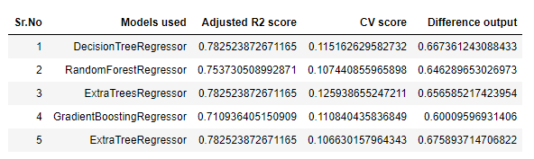
MODEL SELECTION
From the above algorithms GradientBoostingRegressor seems to be an ideal algorithm in this scenario and for this type of dataset.
The difference between the accuracy score and cross validation for this model is very less compared to other models.

Slide 38
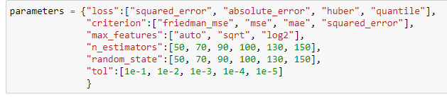
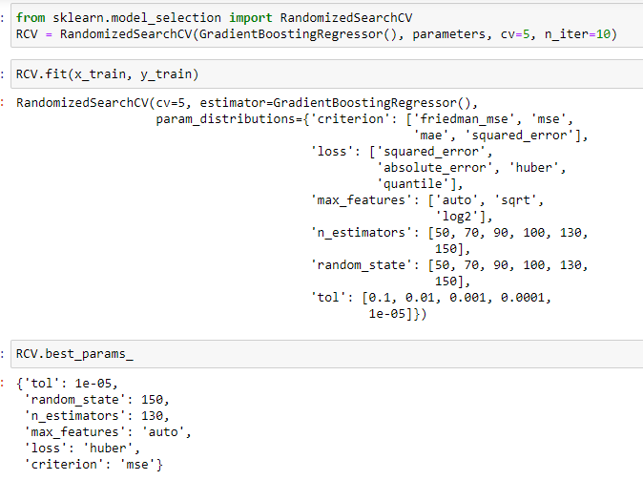
HYPERPARAMETER TUNING
Let us try to tune the proposed model (GradientBoostingRegressor ) to get better accuracy, if possible.
The "parameters" have been selected from the skicit library and I have considered 6 parameters.
RandomizedSearchCV is used to tune the parameters by fitting the same to the training dataset and used the best parameters after selection.

Slide 39
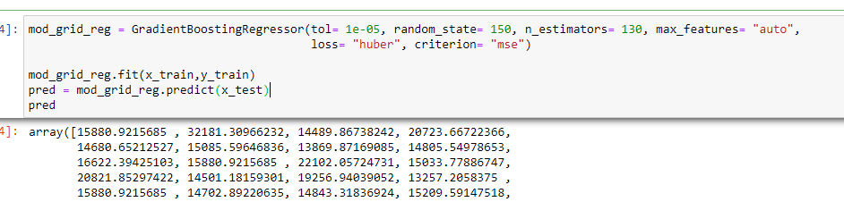
FINAL MODEL ( POST HYPERPARAMETER TUNING)
Rebuild the model using the appropriate params we received from best_params_

Slide 40
Key Findings and Conclusions of the Study
From the EDA , I could observe that pricing depends on the day and also on the brand of the airline.
An airline will charge more as they know customers prefer certain amenities and this also influences the mentality of a customer psychologically.
From this dataset, I observed that flights having multiple stops charge more especially if there are a few flights for that day or flight that takes a specific route or destination.

Slide 41
Learning Outcomes of the Study in respect of Data Science
I realized how difficult it may be when it comes to combining both web scraping and analyzing as I spent more time on scraping the data.
It also depends on the website you are referring to. Some websites have more details, some have less details. It’s best to focus on a selected few as every site has different paths and referencing it may become difficult.

Slide 42
Limitation of this work and Scope for Future Work
This dataset consists only of 1981 records and ideally it’s very less.
There are only 7 features and all appear to be generic. When it comes to price prediction there is a possibility of various other factors like discounts, coupons, food provision etc.
This dataset is only for one specific day and we cannot really say if prices would remain the same for other days.
The only destinations in this dataset are Delhi and Chennai and the source is Bangalore and there is a small chance of getting different output due to lack of options.
SInce the dataset is acquired from the scraped data, it's not necessary that we will get the same or similar data next time as dynamic websites keep changing the contents.

Slide 43
THANK YOU…

